Slide 1
Linux Workshop
by: Evan Peres
Notes:
my goal today is to teach you to think like a linux user
everyone who learns to program understands the flow of code, how loops and functions and arrays work
i wanna do that for linux, the basic operations
if you need help or have questions or concerns, please stop me so i can help, i can explain more, explain less, or explain differently
wanna know more about concepts PLEASE ask, more knowledge is better

Slide 2
Setup

Slide 3

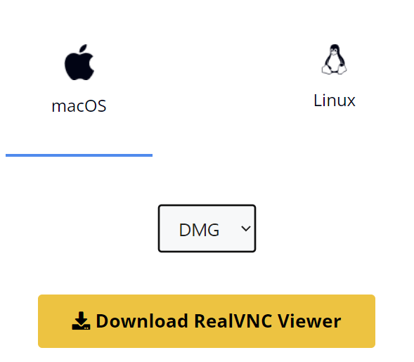
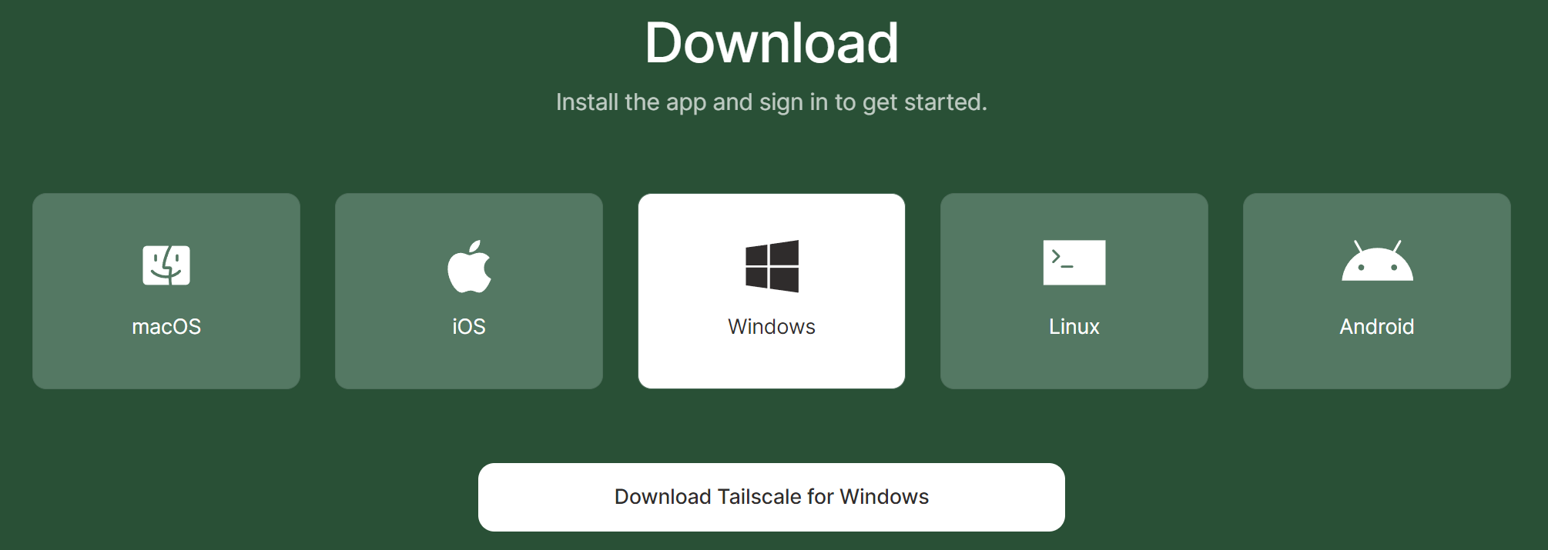

Download and Install Software Before Coming!!
VNC Viewer Softonic for Windows
Real VNC for Mac
Tailscale
Notes:
this will let us control the pi from our laptops
don't use realvnc, it's worse and paywalled

Slide 4
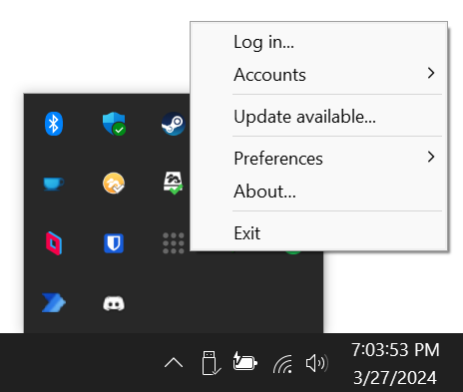
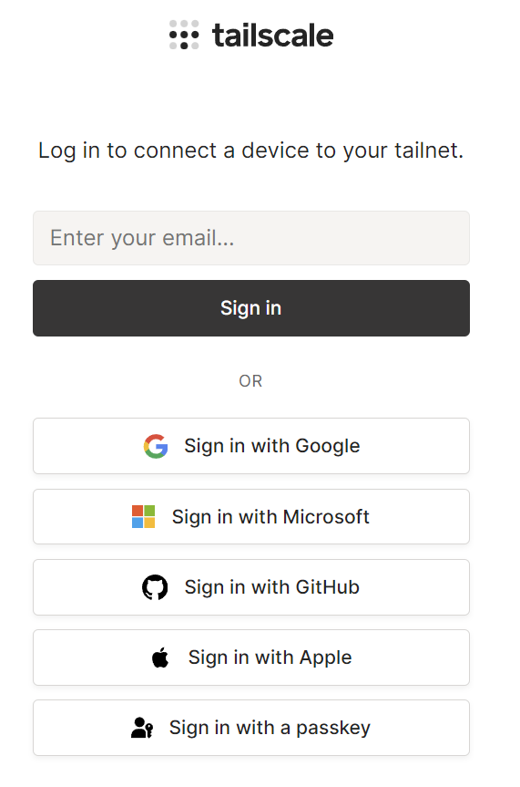
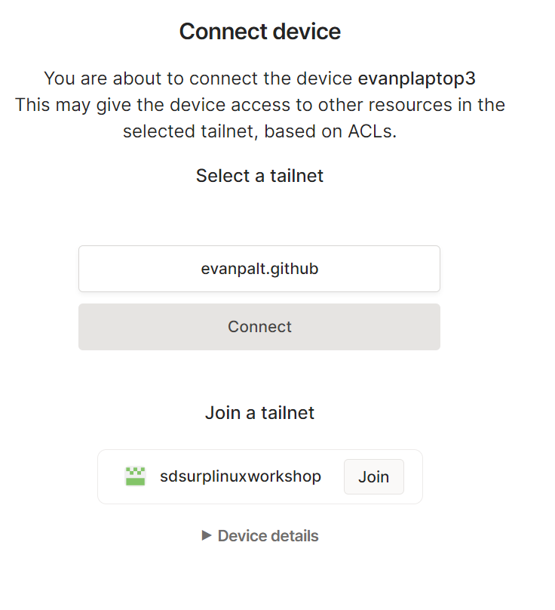
login (can do before session)
Notes:
tailscale is a vpn, makes a virtual network so devices in same github organization can see each other even on different wifi networks,
made the github organization so that all of these devices can see each other

Slide 5
Linux Background

Slide 6
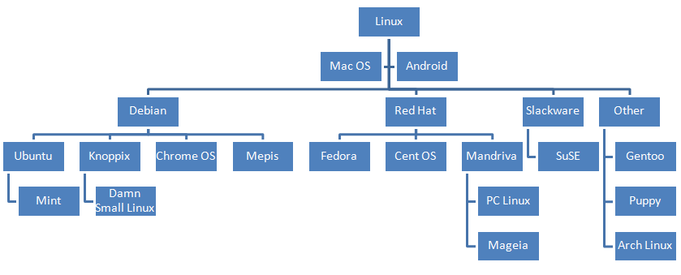
Notes:
linux the underlying
distros diverging
debian -> ubuntu -> mint (very sim)
not actually gonna use, important to know for research that there are differences

Slide 7


Notes:
we use mint or ubuntu, same i like mint, nothing you can't get around with some know how
current server runs ubuntu server, headless, aka no gui only terminal
i want to switch to mint maybe or just install a gui on server

Slide 8
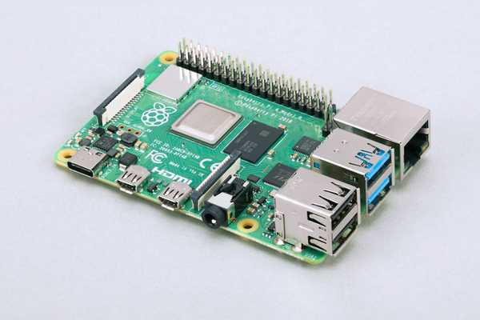

Notes:
using pi, rasbian like verys tripped down debian,
identical operation, nearly identical environment
be warned pis are very slow, give them some time
always shut down properly cuz microsd unstable
don't worry about low voltage warnings, it doesn't actually affect us for what we’re doing (i ran on low voltage for a whole semester)

Slide 9
Pi Setup

Slide 10
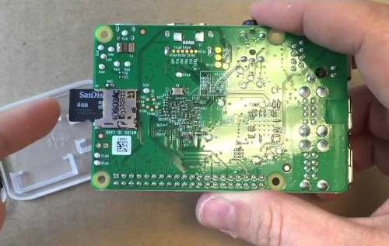
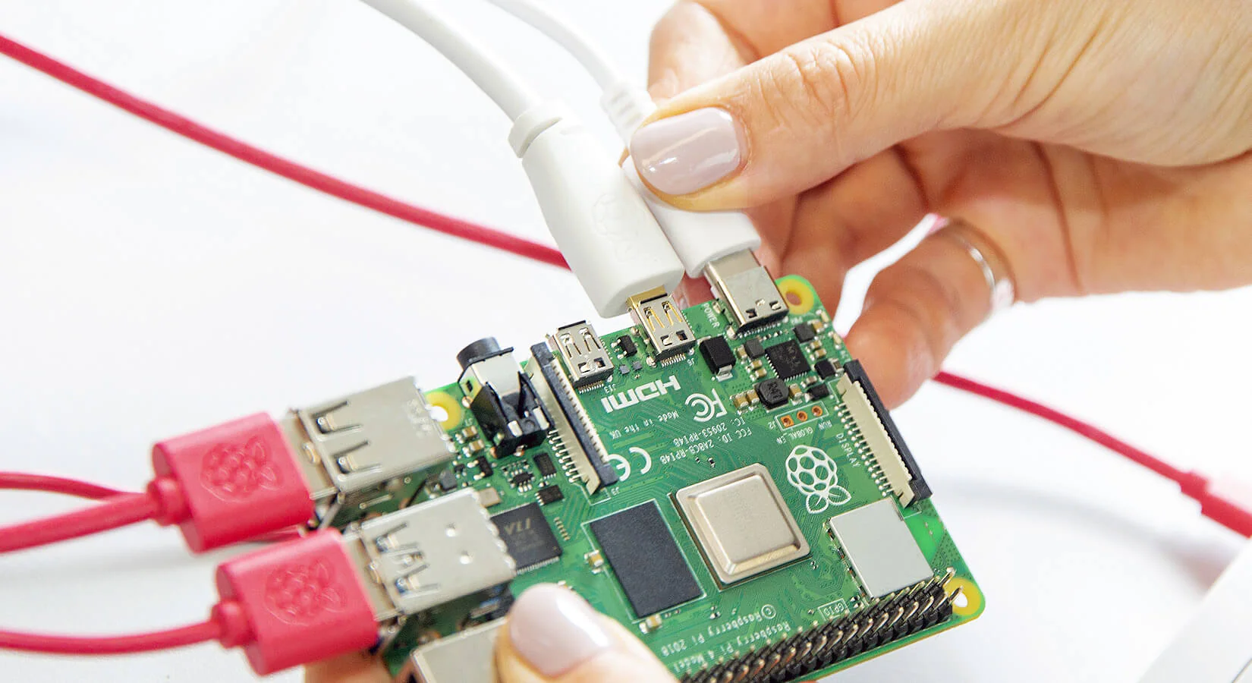
Notes:
pi no power button, turns on with connect cable
connect keyboard mouse monitor and sd card first, then power
red light power, green light writing so don't unplug on green

Slide 11
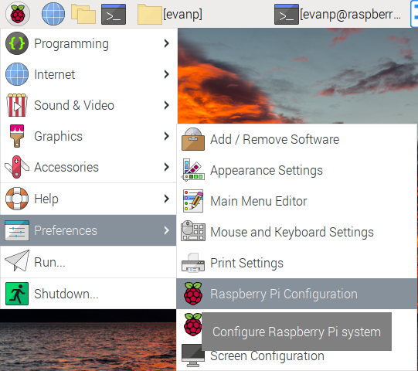
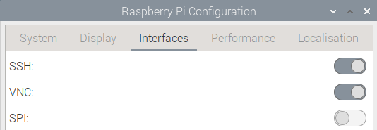
Notes:
ssh and vnc will help us later so we need to turn them on

Slide 12
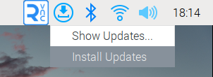
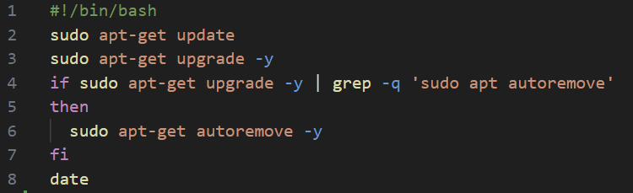
Update & Upgrade
sudo apt update
sudo apt upgrade
sudo apt install ufw
sudo nano uu.sh
Notes:
explain terminal and how commands work
open terminal, simplest commands, update commands, add the extra updates
explain apt apt-get
explain sudo and root user
ufw is a firewall management program that's installed by default in ubuntu and mint, but we have to add it for pi. will use it later but wanted you to download something first
pipe and && and sh (shell) and bash (show off file recovery)
explain -d -f -df etc standalones change how command operates, some select specific files, more options
indent in shell script is two spaces

Slide 13
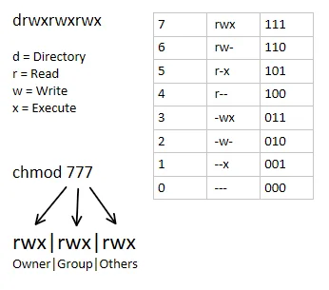
uu.sh
./uu.sh
ls -l ./uu.sh
sudo chown sdsurp:sdsurp ./uu.sh
ls -l uu.sh
sudo chmod u+x ./uu.sh
ls -l ./uu.sh
sudo chmod 754 ./uu.sh r=4 w=2 x=1
ls -l ./uu.sh
Notes:
the ls command lets us see information about files
how to give files permissions.
explain users and groups, root user, notice that sudo nano made a file owned by root
explain filesystem

Slide 14
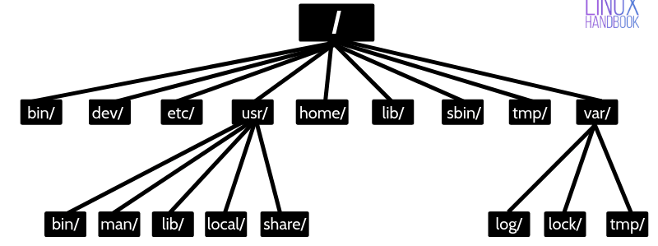
cd = change directory
pwd = print working directory
~ = home directory
/ = root directory (equivalent of windows C: drive)
cd ./foldername = enter child folder under working directory (down the tree)
cd .. = enter parent folder above working directory (up the tree)
cd /folder/folder/folder = move to this folder from anywhere! (teleportation)
mkdir = make a folder in the working directory or anywhere
Notes:
explain working directory, where things happen, the ls files are in the working directory
home and root, fixed locations, it's a tree, root folder belongs to the root user gotta use sudo
basically the up down in the tree
jump anywhere
blank cd will take you to your home folder
have them play around with cd and mkdir

Slide 15
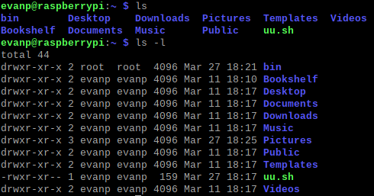
ls
ls = list directory contents
ls = lists every visible file
ls -a = lists all files including hidden files (files that start with a . are hidden)
ls -l = lists permissions and date modified for all files
ls -l ./file = lists only that file’s info

Slide 16
Move files
mv [options] source_name destination_name ex: mv test.txt ./Desktop/test.txt or mv test1.txt test2.txt (renamed!)
mv [options] source1 source2 source3 destination_path ex: mv test1.txt test2.txt test3.txt ./Desktop (moves files or folders into Desktop)
mv ./source ./destination
-i interactive -f force
Notes:
interactive asks if there's a conflict, otherwise default overwrites
force does it even if there are issues

Slide 17
Copy Files
cp [options] source destination (already existing files will be overwritten!) ex: cp test1.txt test2.txt or cp test1.txt ./Desktop/test2.txt
cp [options] source1 source2 source3 destination_path ex: mv test1.txt test2.txt test3.txt ./Desktop (copies files to Desktop)
cp -R source destination (copies folders!) ex: cp ./test1 ./test2 (copies test1 folder into test2)
-i interactive -f force -R recursive
Notes:
recursive does for folders cuz has to do it for everything inside the folder

Slide 18
Delete Files
rm [options] target ex: rm test.txt
rm [options] target1 target2 target3 (removes multiple!) ex: rm test1.txt test2.txt test3.txt
rm -R ./target (removes folders!)
-i interactive -f force -R recursive

Slide 19
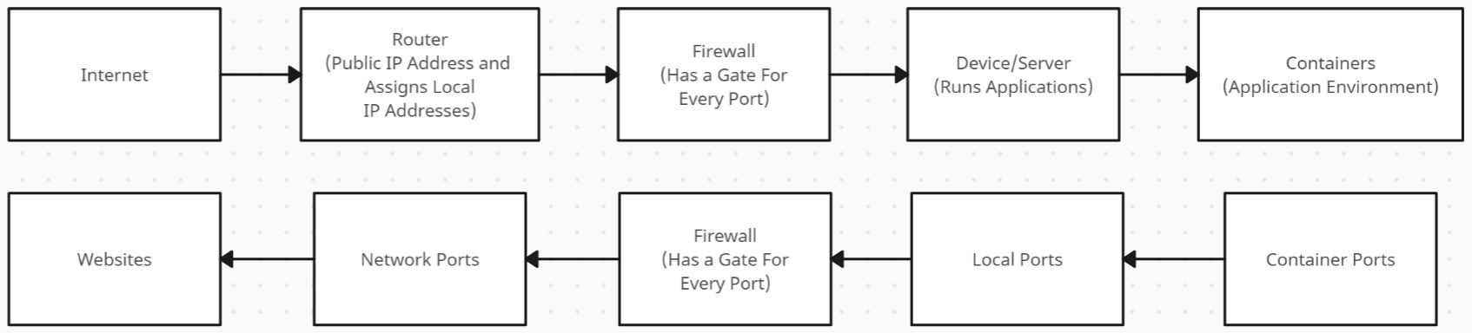
Network/Port Hierarchy
Reverse Proxy
(usually 80 and 443)
Notes:
explain ports and how to connect apps
mention TCP/UDP exist
explain 22, 80, and 443 and http and https
port forwarding is mapping a lower level port to a higher level port
reverse proxy is sending a specific port to a specific website. reverse proxy routes ports thru the firewall to websites

Slide 20
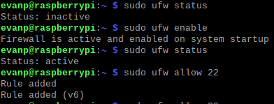
Firewall & ufw
sudo ufw status
sudo ufw enable
sudo ufw allow 22
sudo ufw allow 80
sudo ufw allow 443
sudo ufw allow 5900
sudo ufw status
Notes:
ufw is preinstalled on ubuntu and mint, firewall manager
we enabled the ports we need for ssh and to host internet traffic

Slide 21
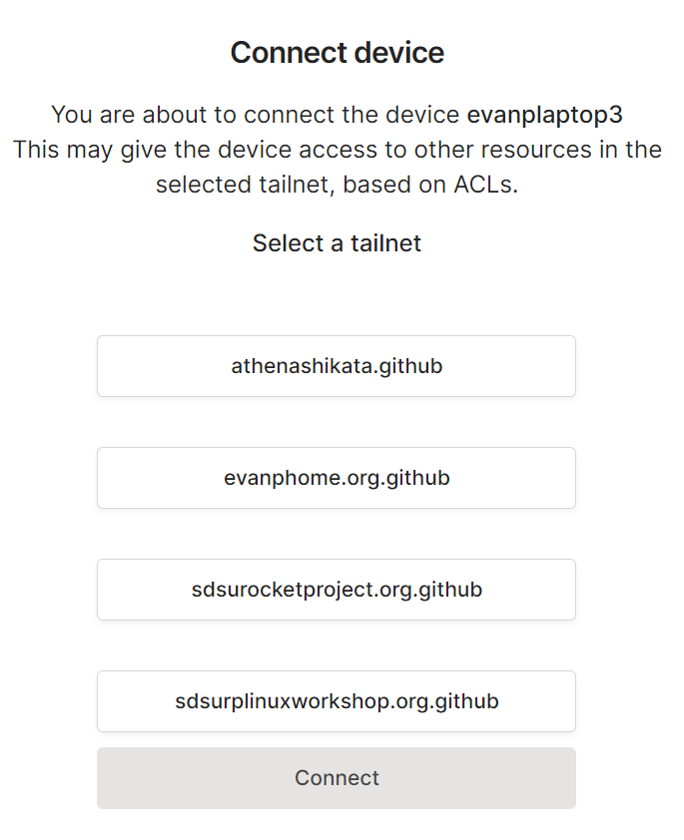
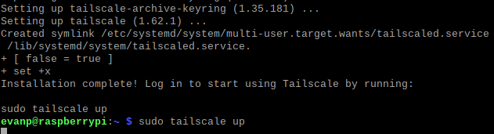
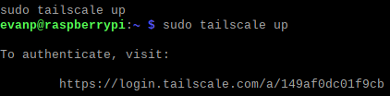
Tailscale
curl -fsSL https://tailscale.com/install.sh | sh
sudo tailscale up
sudo tailscale status
Notes:
curl pulls something from the internet
looks complicated it's not. just like when you installed it earlier
run the script, run a command, open a link, log in, check the status
if you want run ping and the ip address of your laptop

Slide 22
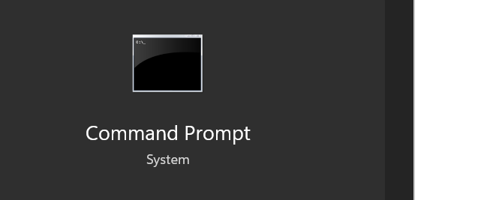
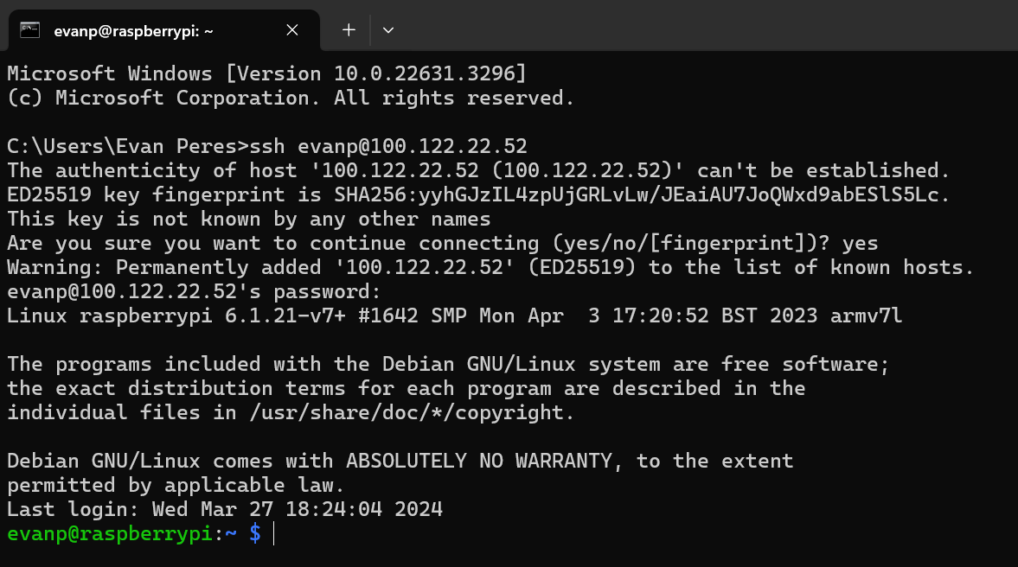
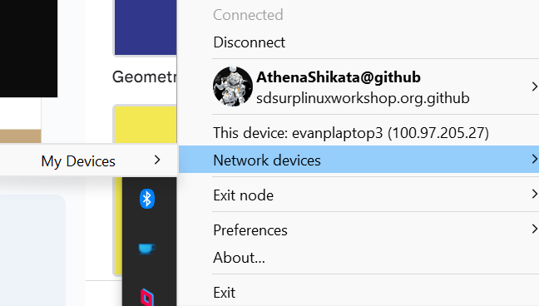
SSH
ip a
sudo tailscale status password: changeme
Notes:
ssh is a protocol to allow remote access to other computers on the same network
normally you would run the ip a command and connect from another computer to that, but school wifi weird
we will be using tailscale as our network
go to the tailscale tray icon, hover over network device, then my devices, then click the raspberry pi. this copies that ip address. it's the same one listed in tailscale status
open cmd, ssh user@ip, fingerprint yes, password yes

Slide 23
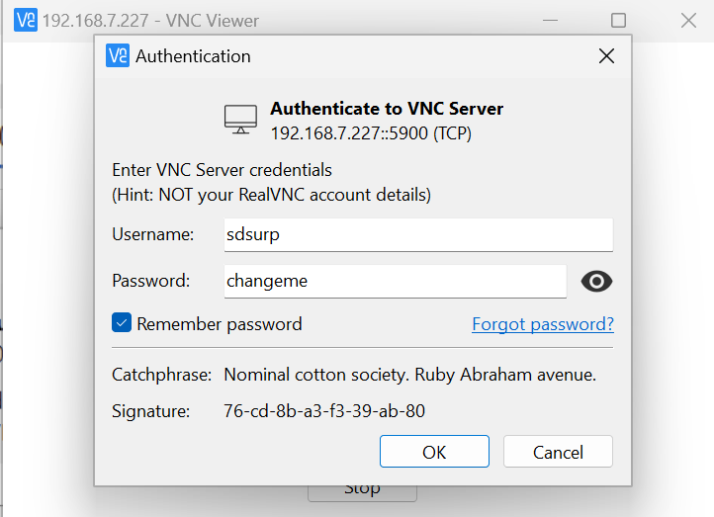
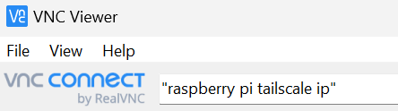
Connecting With VNC
Notes:
now we open vnc viewer
it's like ssh but for the whole keyboard mouse and monitor
enter ip in the top, enter credentials and remember password and join
vnc is optional for today because everything is in terminal, but very useful for actual stuff

Slide 24
Docker
sudo apt install docker if it fails: curl -sSL https://get.docker.com | sh
sudo apt install docker-compose
sudo usermod -a -G docker evanp
sudo reboot (you’ll need to reconnect to ssh and vnc)
Notes:
so many OSs and so much hardware makes predicting software behavior difficult
if a computer is a pool of mystery liquid, a container is a box for a single program
each box is identical, so they all act the same
you can poke holes in the box so the program can access the network and filesystem and you can bridge them together
docker is the program that creates and manages containers
explain docker compose and why not regular docker run

Slide 25
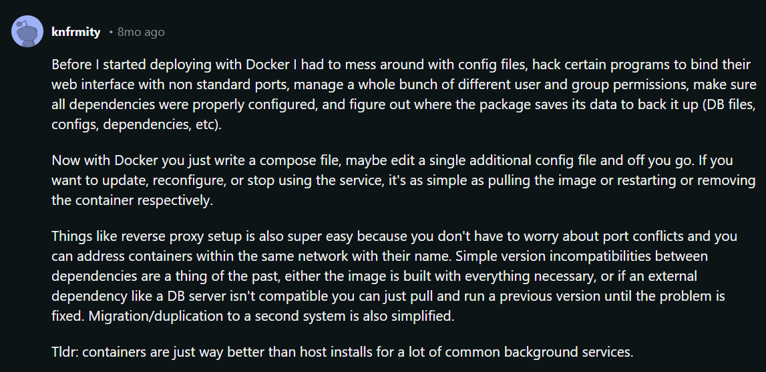
Notes:
i use docker to keep stuff organized. apt packages are very messy and chaotic. terminal based not as clean as windows applications. docker clean
this guy says it best why i use docker

Slide 26
wget https://raw.githubusercontent.com/AthenaShikata/Random/main/linux_workshop1.yaml
wget https://raw.githubusercontent.com/AthenaShikata/Random/main/linux_workshop2.yaml
sudo mkdir /Docker /Docker/1 /Docker/2
sudo chown -R sdsurp:sdsurp /Docker
mv ./linux_workshop1.yaml /Docker/1/docker-compose.yaml
mv ./linux_workshop2.yaml /Docker/2/docker-compose.yaml
cd /Docker/1/
nano ./docker-compose.yaml
Notes:
wget is like curl, but it is usually used just to download a file hosted at a specific url
what we are doing now is downloading these docker compose files, making directories for them, moving them and renaming them
have them wget the files and mkdirs
explain yaml structure and show them in nano
have them launch and access 1
have them fill out, launch, and access 2

Slide 27
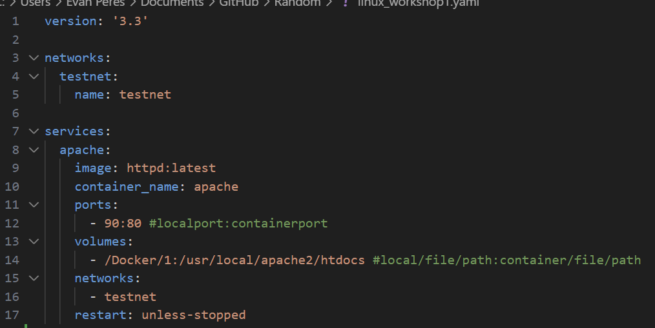

Slide 28
Docker
docker-compose up -d
in the browser go to localhost:90

Slide 29
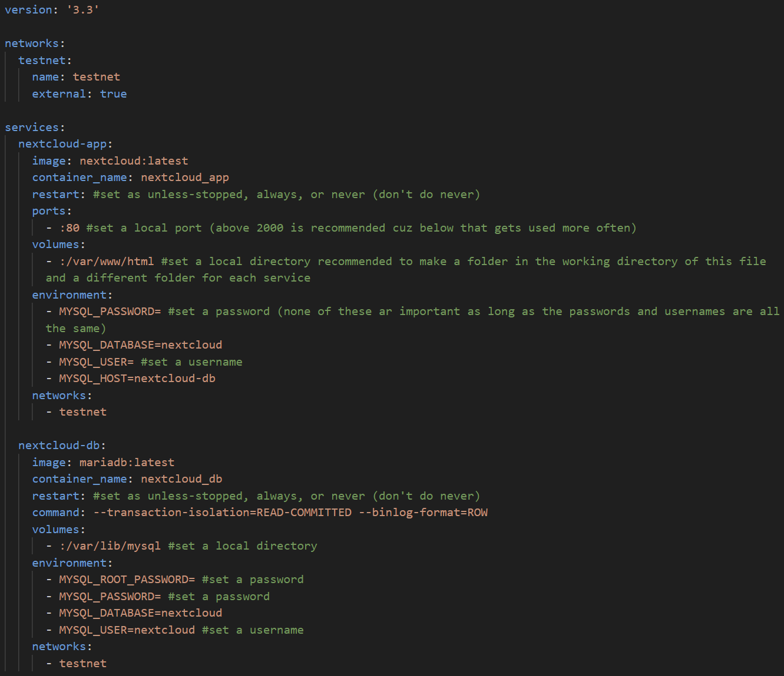

Slide 30
Docker
cd /Docker/2/
nano ./docker-compose
docker-compose up -d
in the browser go to localhost: whatever port you specified
docker-compose down
cd /Docker/1/
docker-compose down

Slide 31
Documentation

Slide 32
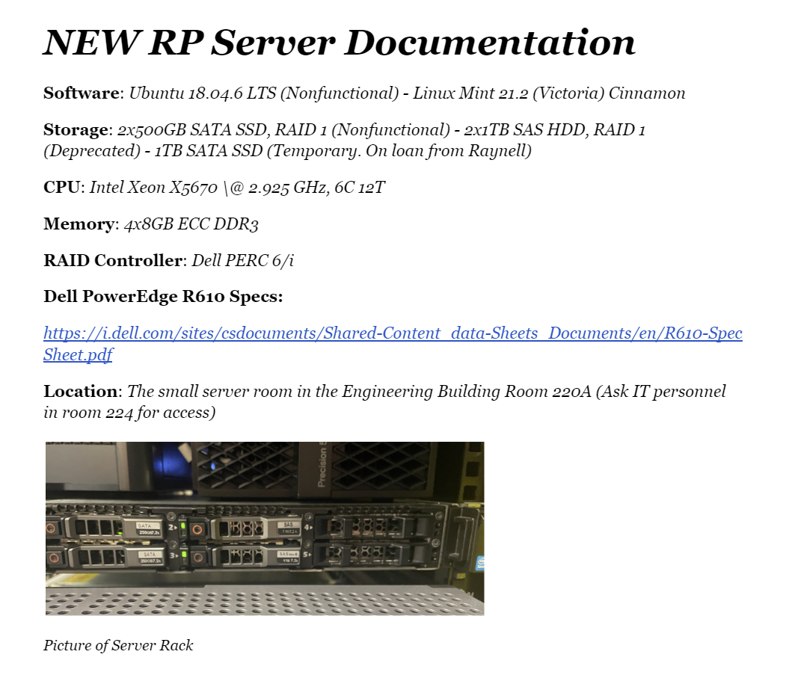
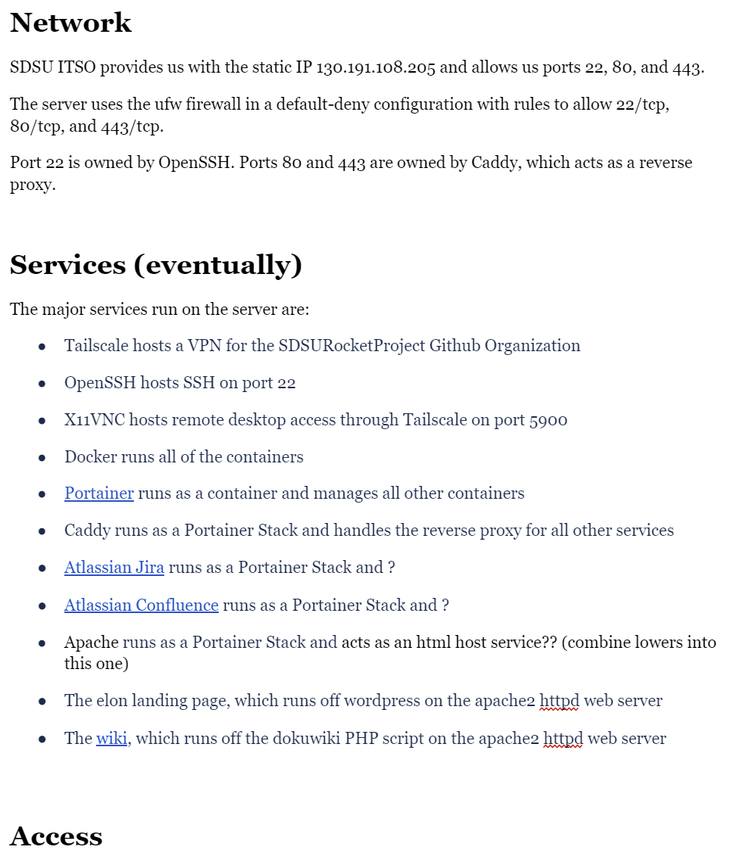
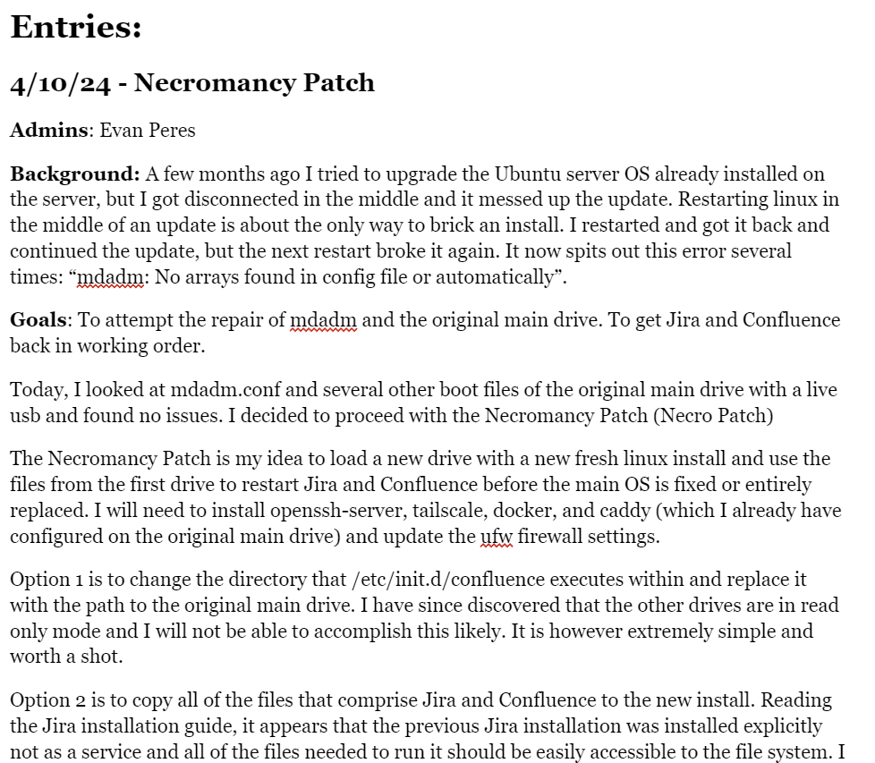
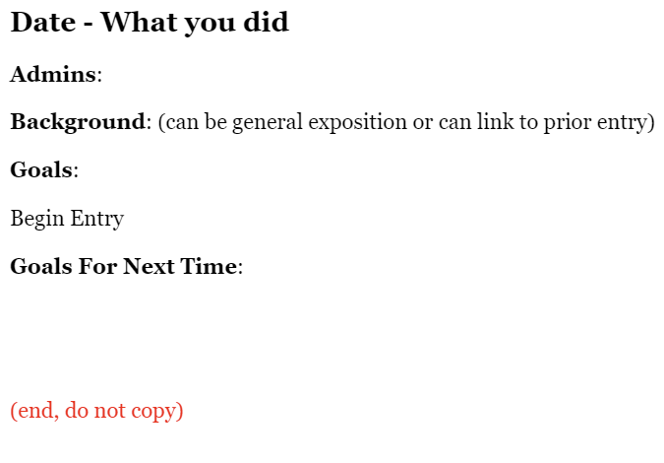
This is What Our Documentation Will Look Like
Copy of the Documentation For Viewing Purposes
Notes:
this is how i want all of our documentation to look. an overview for each system we employ and activity entires detailing exactly what we did, how, and when
we did this in my trade school engineering class and it was very useful even tho we didnt need to go back that much
i want us to have the best documentation in rp

Slide 33
Experimentation

Slide 34
If you wanna try this out for yourself
I don’t recommend vms, I can't get them to work properly
Try dual booting or use and old laptop or desktop as a home server
Look up self hosting projects like jellyfin, nextcloud, seafile, vaultwarden, etc
Use portainer, it's cleaner browser based docker compose
Google and stack exchange are your best friends for everything. “90% of a programmer's time is spent looking for someone else’s solution” (quote: my mechatronics teacher) and it's the same with linux users
Buy a cheap website to host on
Setup multiple minecraft servers at once (dm for the dns records cuz the internet is randomly really bad at explaining how to set them up properly)
Notes:
slide

Slide 35
Questions?

Slide 36
Link to lots of linux commands
https://github.com/AthenaShikata/Random/blob/main/many%20linux%20commands.txt

Slide 37


